Slide 1
Career PreFerences & Workplace Insights Dashboard
ÆO O O O O O O O O

Slide 2
This dashboard provides a comprehensive analysis of career motivations, workplace preferences, salary expectations, and key job-related factors among survey respondents. Use this dashboard to explore what influences career choices, the distribution of working environments, gender-based patterns, salary expectations, and the most common motivators and frustrations at work. The visualizations help identify trends, dominant preferences, and potential areas for organizational improvement.
Nearly half of respondents (49.7%) work in a hybrid model, making it the most common working arrangement.
Fully remote work is preferred by 39.3% of respondents, significantly more than the 11% who work exclusively in an office.
The "Political Environment" is the dominant frustration factor, reported by 96.4% of respondents, with all other frustrations combined accounting for less than 4%.
Respondents from India overwhelmingly dominate study abroad responses, with 1,540 indicating "Yes," 769 "sponsored," and 1,170 "No," while other countries have negligible participation.
The largest salary band group (5B9 individuals) moves from early-career salaries above 50k to mid-career salaries above 151k, indicating strong upward mobility for higher starters.
Early-career mid-tier salaries (31—40k) most frequently progress to mid-career salaries in the 71—90k range (200 individuals), showing steady salary growth in this band.
Early-career salaries in the 41—50k range split into two mid-career salary bands: 91—110k (195 individuals) and 111—130k (145 individuals), reflecting varied career progression paths within the same starting salary range.

Slide 3

Total Responses
3595
Remote Preference %
39.33
Layoff Risk %
79.42
40.28

Slide 4
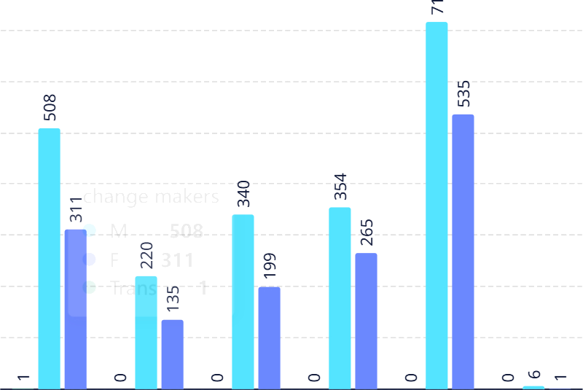







Top Influencing Factors by Gender
LayoFF Risk and NO-REMOTE Policy
Distribution
No ■ Yes
Trans ■ M W F
800
700
5
99
600
N 0
500
641
400
300
641
200
Yes
100
2.21K
0
0
500
IK
1.5K
2K
2.5K
O O O O O ONO O O

Slide 5
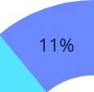
Distribution oF Working Environments
Hybrid Remote
B Office
Nearly half of respondents (49.7%) work in a hybrid model, making it the most common arrangement
Fully remote work accounts for 39.3%, substantially more than office-only (11%), indicating strong preference for flexibility
49.7%
39.3%

Slide 6
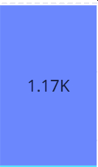
Study Abroad Responses by Country
Yes sponsershiped ■ No
India respondents overwhelmingly dominate all study-abroad categories, with 1.54K “Yes”, 769 “sponsored”, and 1.17K “No” responses
Other countries contribute negligible counts, highlighting a highly skewed geographic distribution
769
1.54K
USA
PAK
Oth er
IND
CND

Slide 7
Salary Expectations at Career Start by Gender
F M B Trans
2.1K
.41K
26k to 30k
 |  |  |  |  | M | 22
 |  |  |  |  | F €f Trans | 20 | 0
1 | 20 | 22 | o | 15 | 14 | o |  | 5 | 12 | 0 | 1
31k to 40k |  | 26k to 30k |  |  | 2J k to 25k |  |  |  | 16k to 20k |  | 10k to 15k

Slide 8
Salary Band Summary
The largest group (589) move from >50k at early career to >151k at mid career, indicating strong upward mobility for higher starters
Mid-tier early-career salaries (31—40k) most frequently transition to 71—90k mid-career (200), suggesting steady progression in that band
Early-career band 41—50k splits into mid- career 91—110k (195) and 111—130k (145), reflecting differentiated career trajectories within the same starting range
 | salary at mid careers | COUNT
>50k | >151k | 589
31k - 40k | 71k - 90k | 200
41k - 50k | 91k - 110k | 195
26k - 30k | 71k - 90k | 155
41k - 50k | 111k - 130k | 145
>50k | 131k - 150k | 142
31k - 40k | 91k - 110k | 140
>50k | 111k - 130k | 134
41k - 50k | >151k | 126
41k - 50k | 131k - 150k | 120

Slide 9
Frustration Factors Distribution
The “Political Environment” overwhelmingly dominates as the top frustration factor (96.4%)
All other factors combined represent less than 4% of reported frustrations, suggesting a unanimous concern over organizational politics
Political Environment
Unclear work without any goals B Unsupportive Managers
B High stressful job Lack of Transparency
Unclear work with a goal
Often a need to learn New Skills
96.49t

